Slide 1
徐勇志 个人分享 新南威尔士大学 博士 测量工程 北航 硕士 精密仪器及机械 南航 本科 飞行器设计 基于物体检测的室内结构重建 2021-2-28

Slide 2
Outline
Research problem
Background
Proposed approach: Floor-Det
Proposed approach: Corner-Det
Discussions

Slide 3
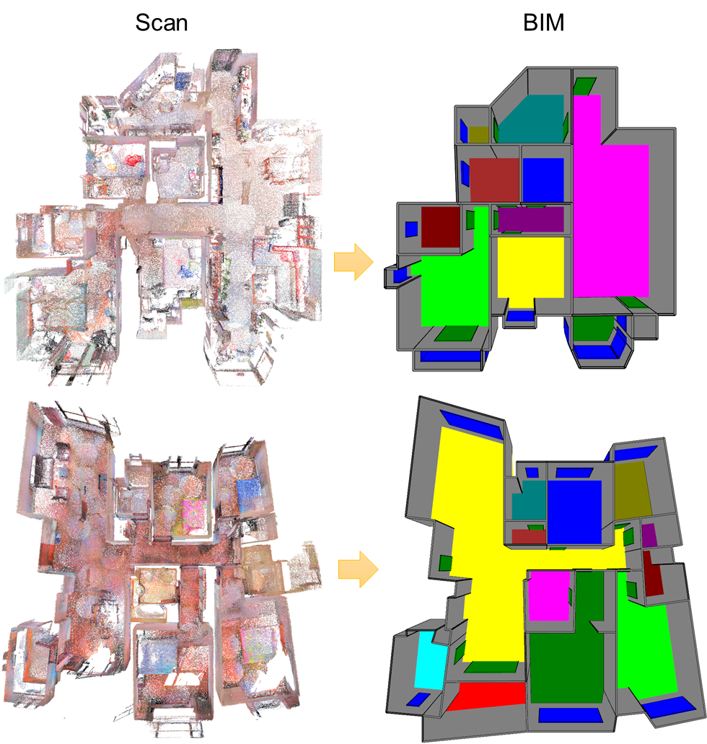
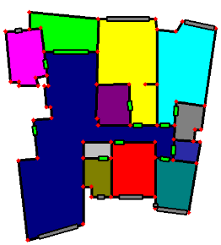
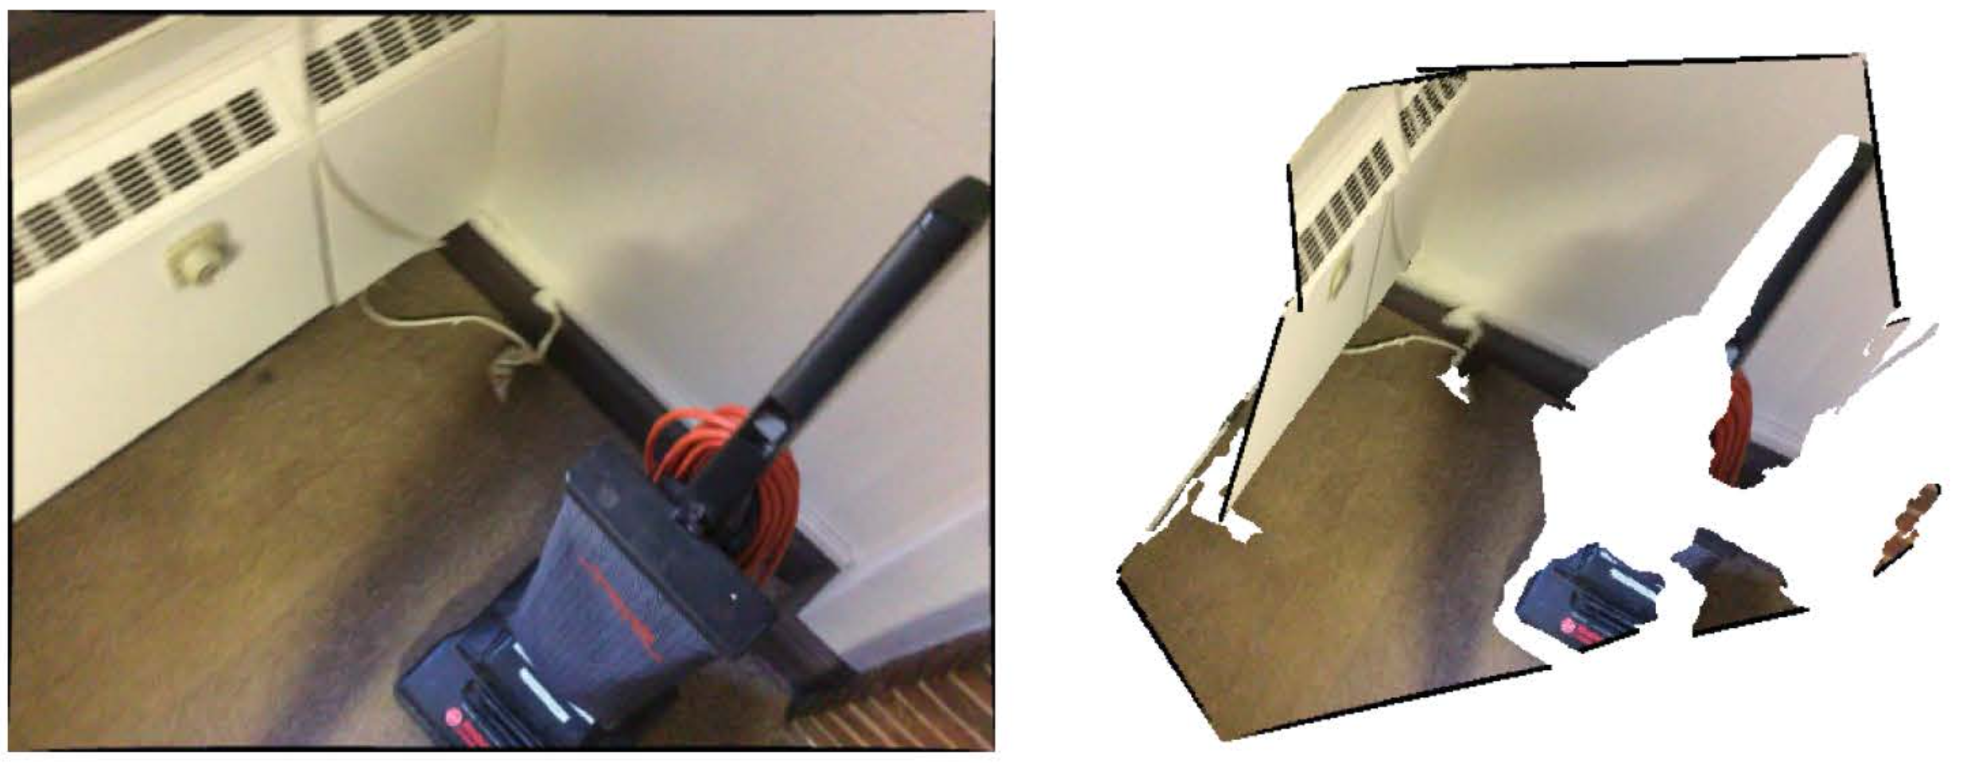
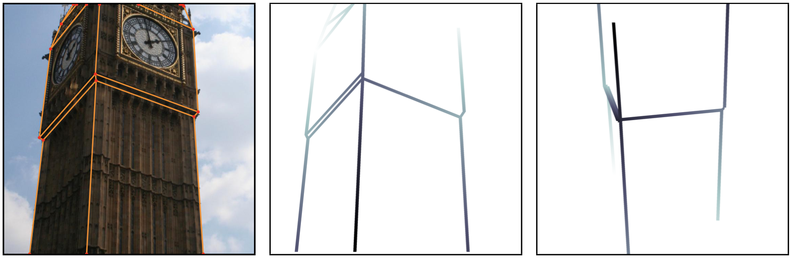
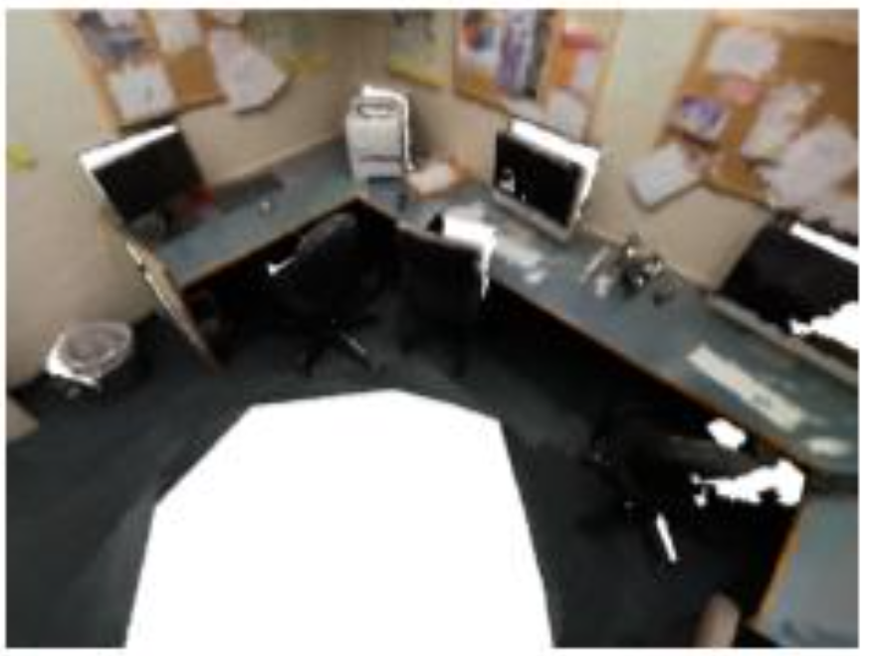
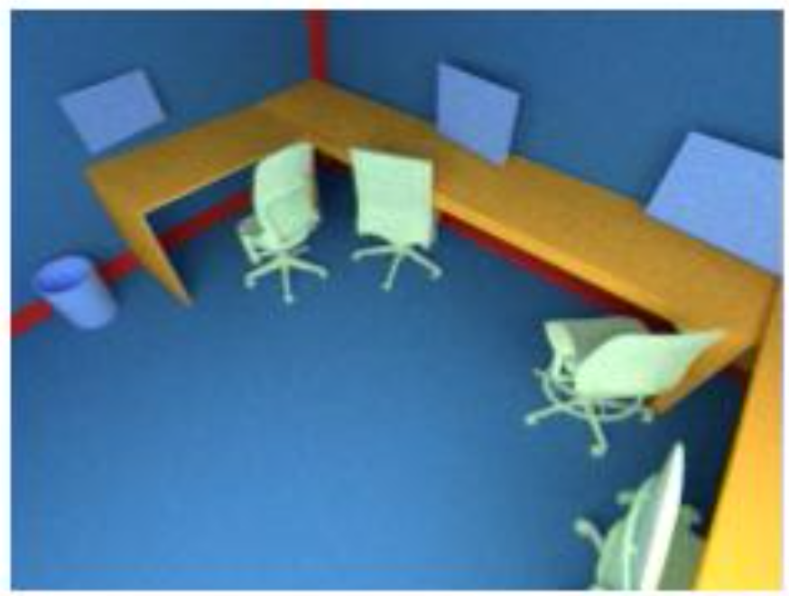
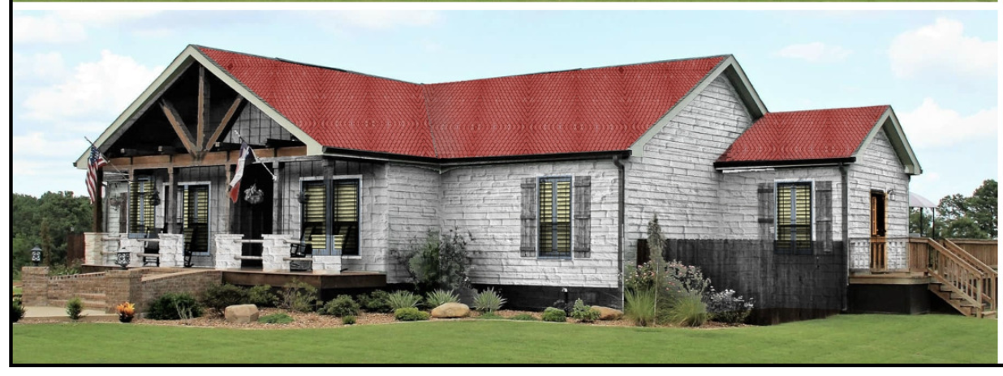
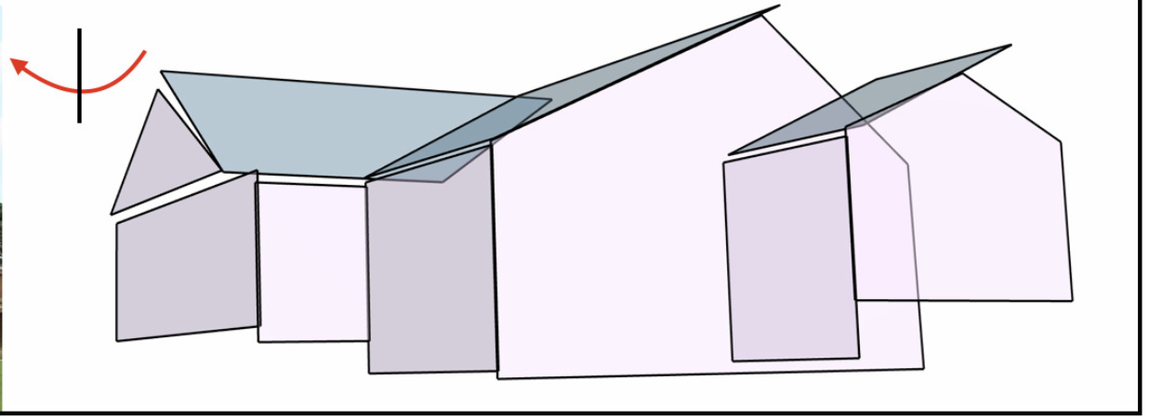
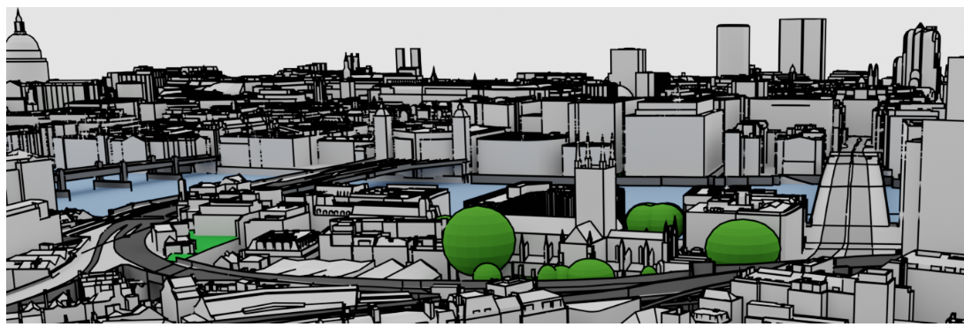
Research problems
Scan
3D Layout
Floorplan
Structured modelling
Scan-to-CAD
Floorplan reconstruction
Holistic planar reconstruction
Still an open problem:
How to capture structural information?
How to recover structural graph?
How to apply to general tasks?

Slide 4
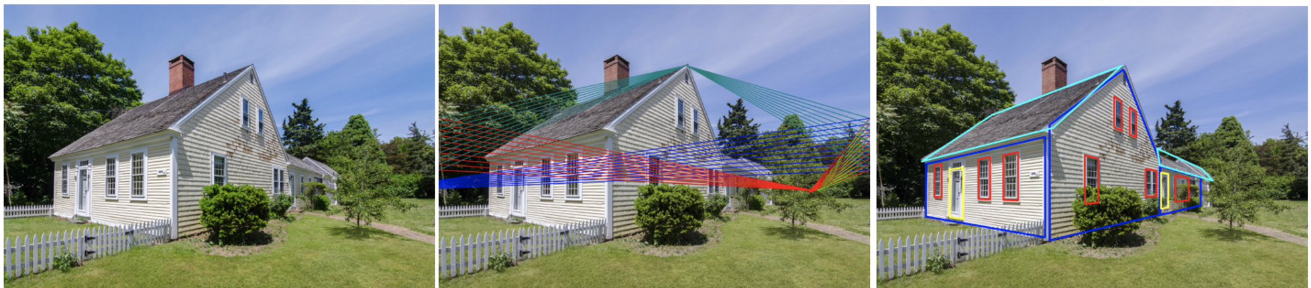
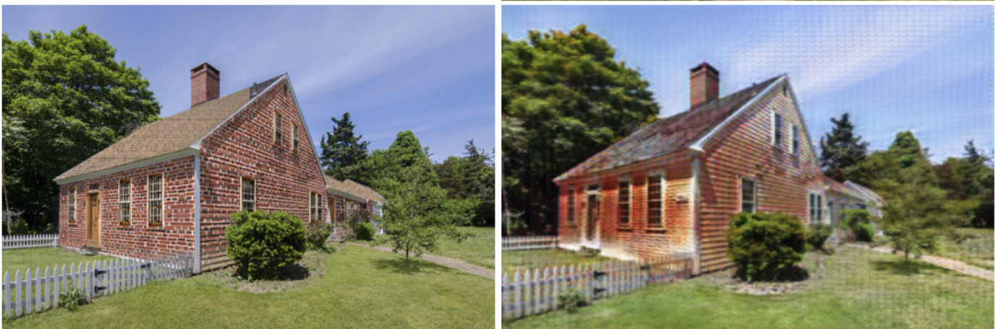
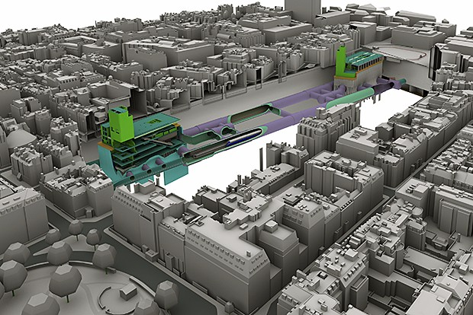
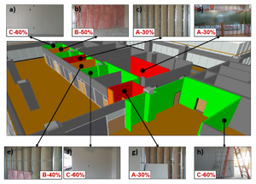
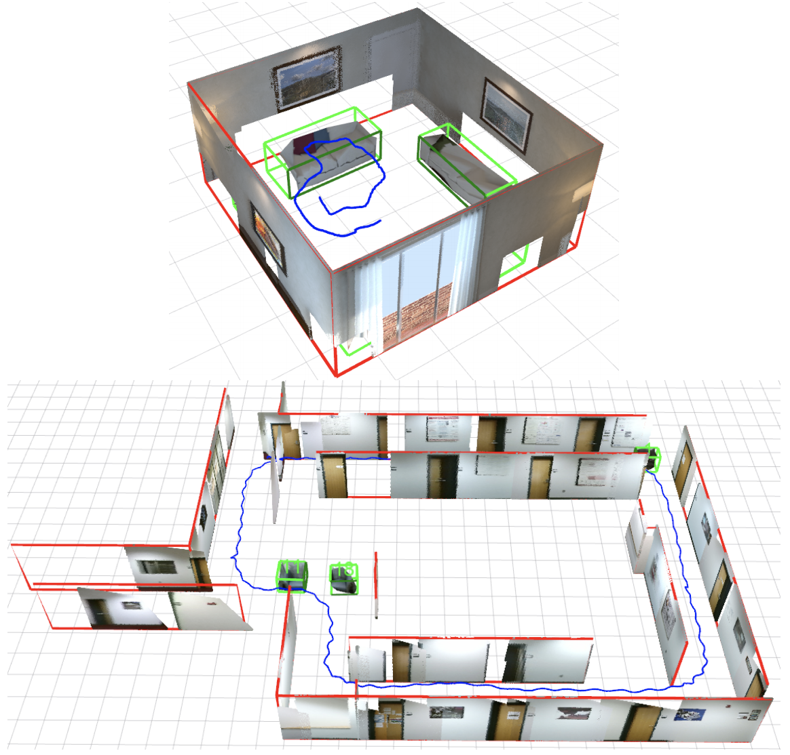
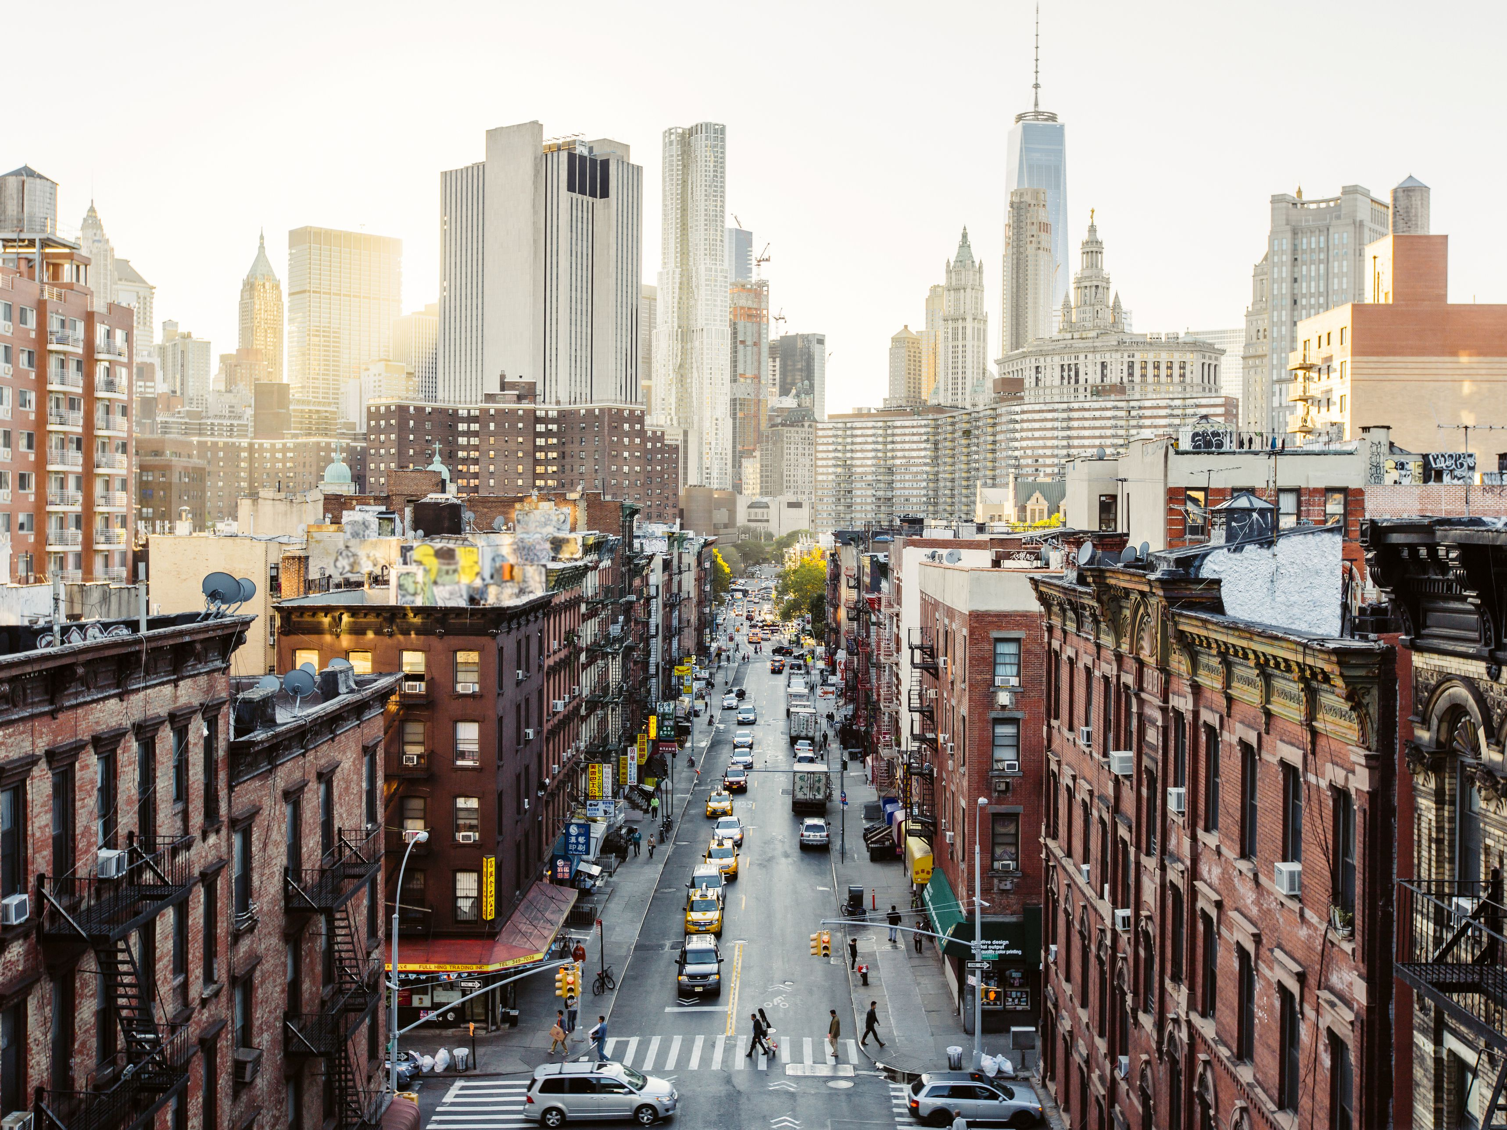
Applications
GAN
GAN: 1) unaware of building structure or vanishing geometry, introducing various artifacts in close-ups; 2) a user is not able to control what new material or asset to insert.
Structural SLAM
compare
Location
BIM Progress monitoring

Slide 5
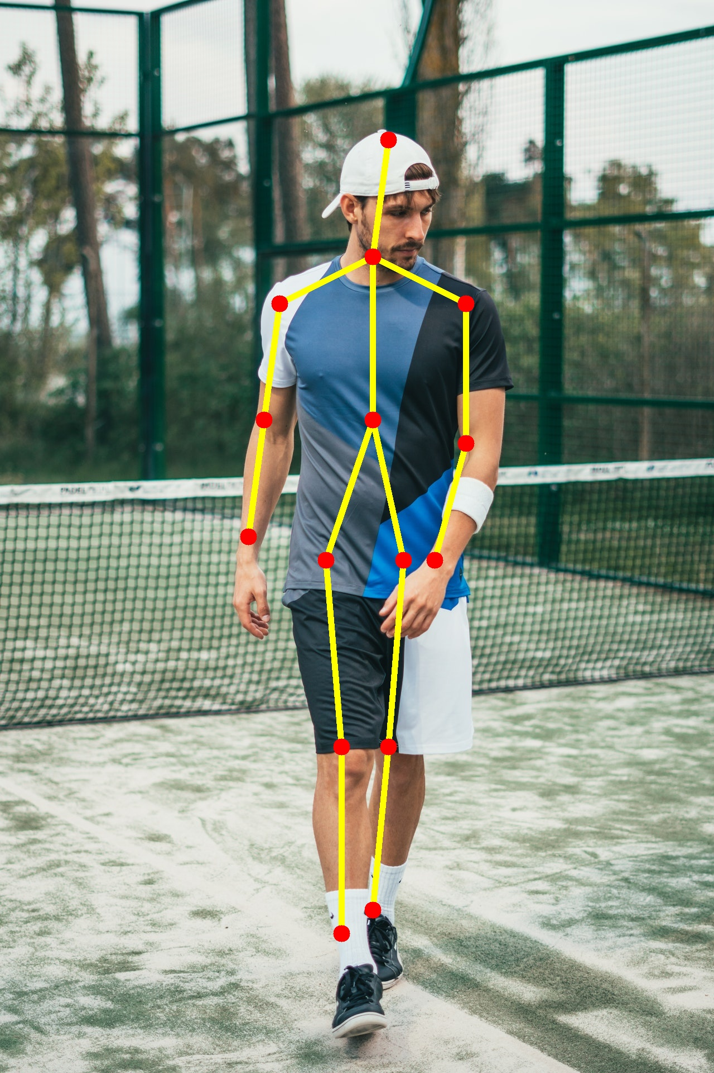
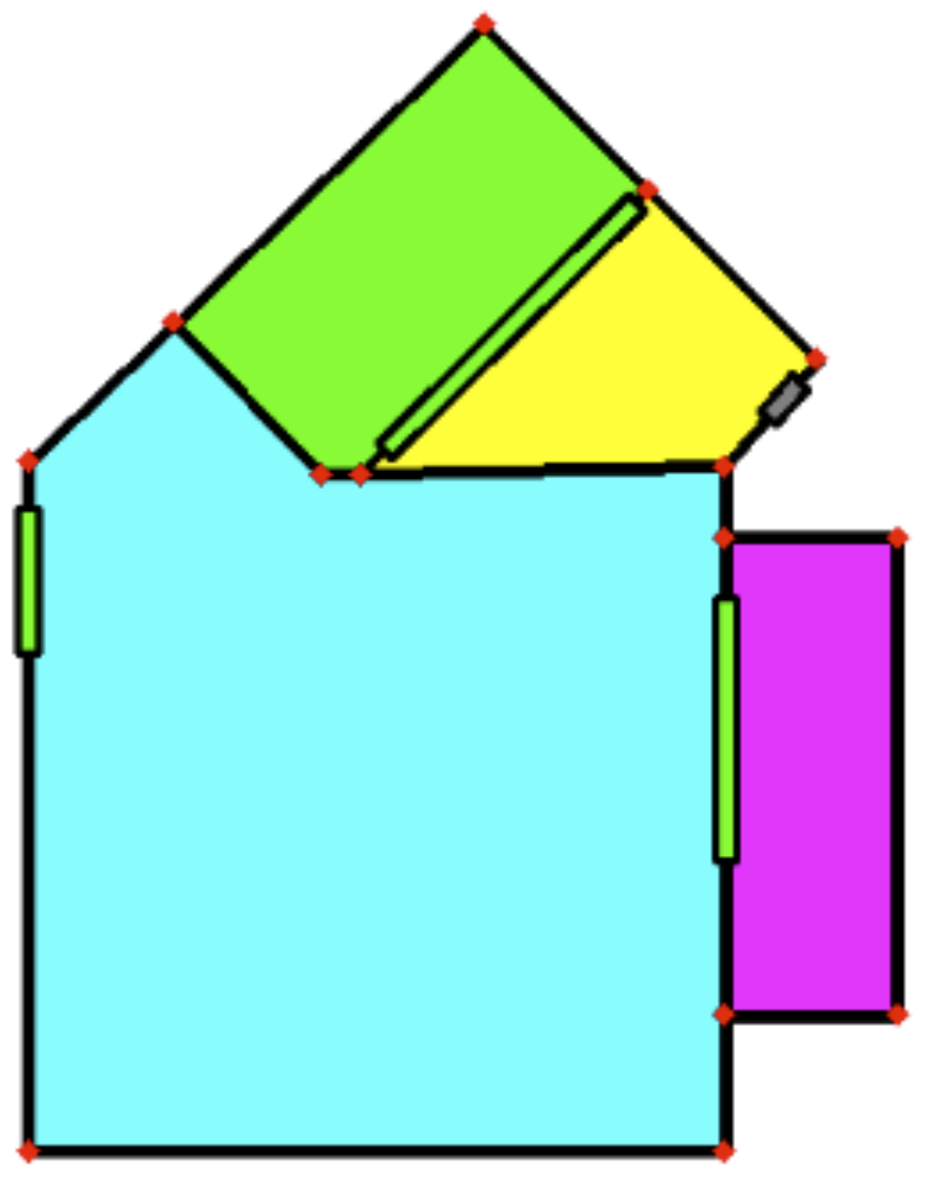
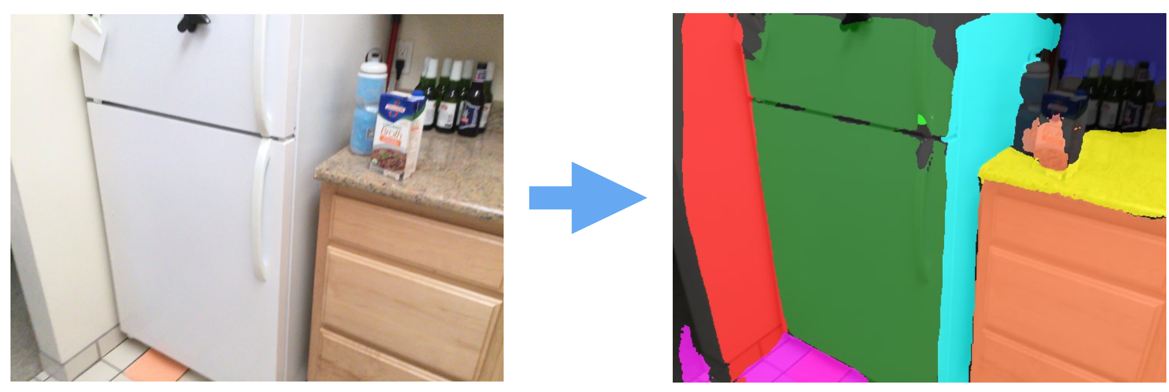
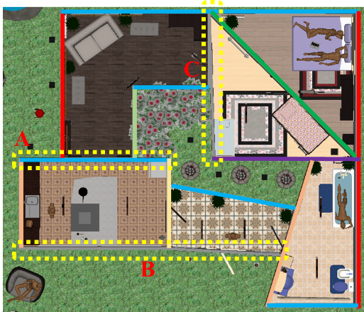
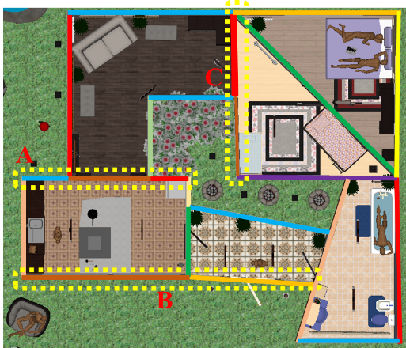
Key challenges
​Arbitrary topology
​Efficient representation and decomposition
​End-to-end learning of structure information: fewer heuristic rules
•​ Instance sensitivity
Fixed topology
Arbitrary topology
Non-parametric reconstruction
longest wall pattern
shortest wall pattern

Slide 6
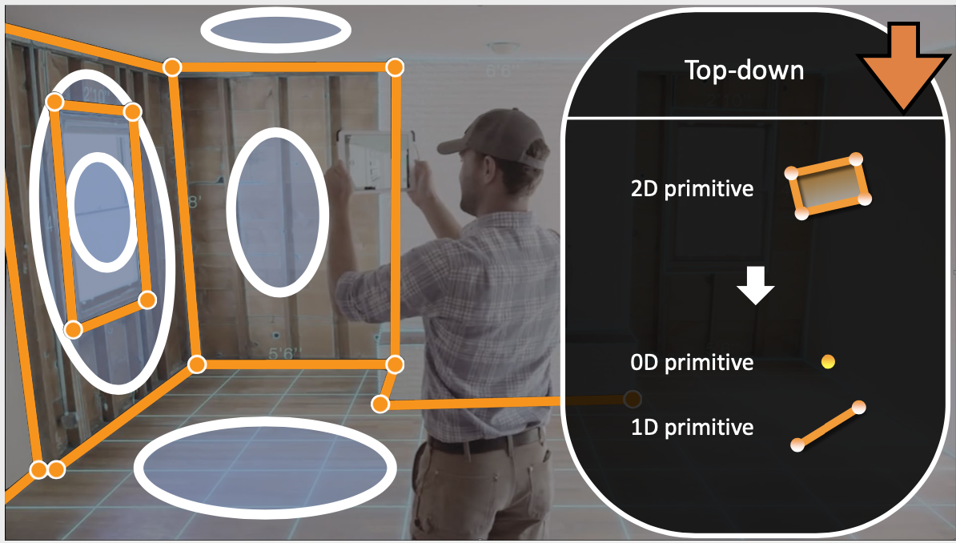
Decomposition of graphs
•​ Corner-based: Bottom-up
•​ Region-based: Top-down
•​ Edge-based: under development ?

Slide 7
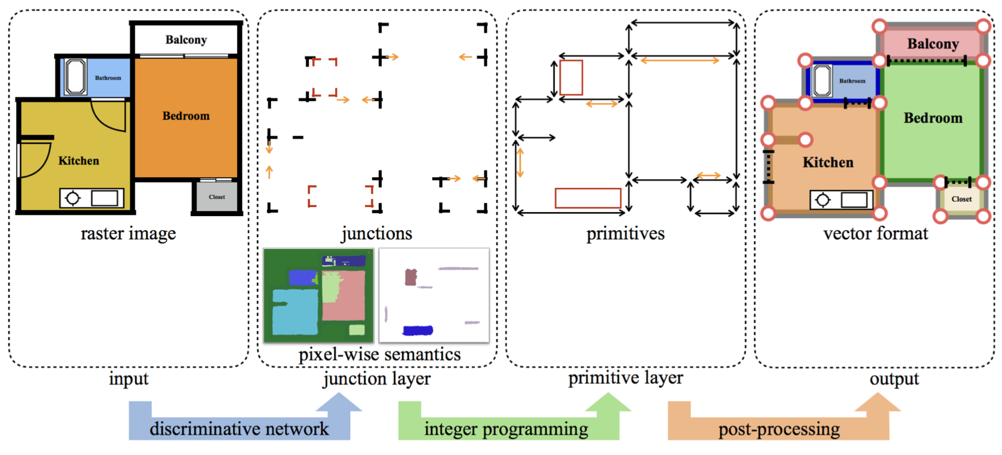
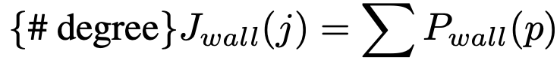
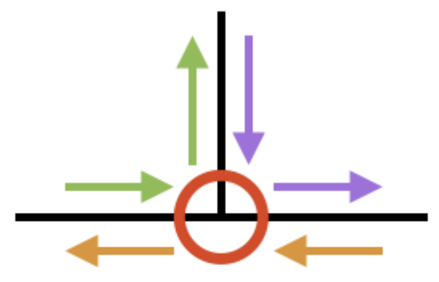
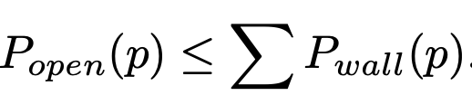
Bottom-up approaches
Liu, C., Wu, J., Kohli, P., and Furukawa, Y. “Raster-to-vector: revisiting floorplan transformation.” ICCV, 2017.
Constraints in integer programming (Gurobi):
Junction degree
Decomposed loop constraint
Opening on wall
IP remove spurious junctions and primitives, but cannot recover missed ones.
IP is slow, under 256*256, 2s for Manhattan.
Structure prior only used in IP, not junction detection and region segmentation.
Semantic seg + 11 room types ~= instance seg ? => loop constraint
Classification of junction types is not robust: hallucinate 2 L and one T for each T.

Slide 8
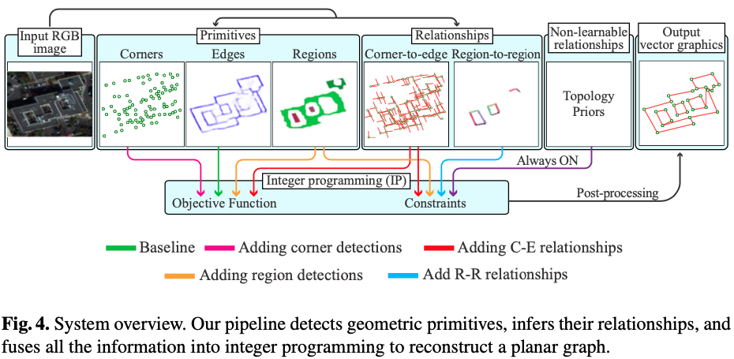
Bottom-up approaches
N. Nauata, Y. Furukawa, Vectorizing World Buildings: Planar Graph Reconstruction by Primitive Detection and Relationship Inference, ECCV 2020.
Four pixel-wise tasks: (1) corner heatmap, (2) edge semantic seg, (3) region instance seg, (4) region-to-region instance seg
Corner-to-edge: (1) classification of 15 agular bins per corner, (2) used in IP to connect corners.
Region-to-region: (1) semantic mask of common edges, (2) used in IP to encourage edges

Slide 9
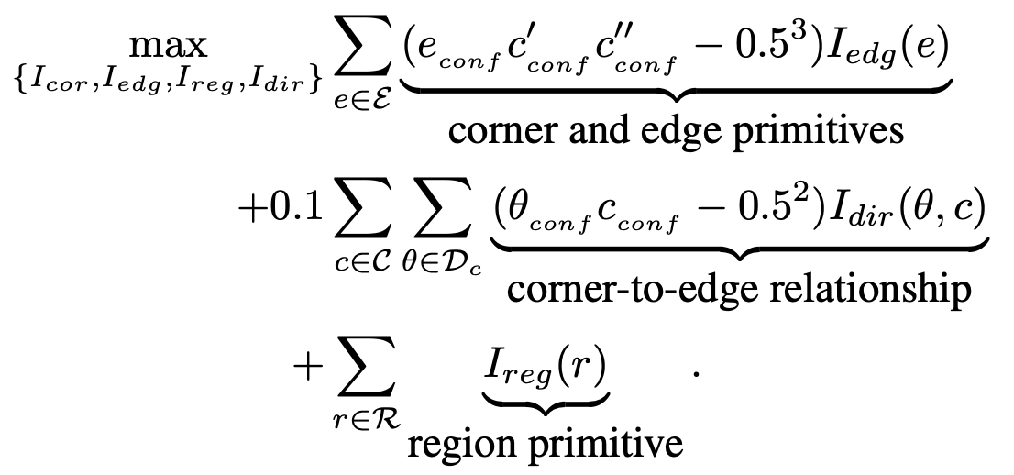
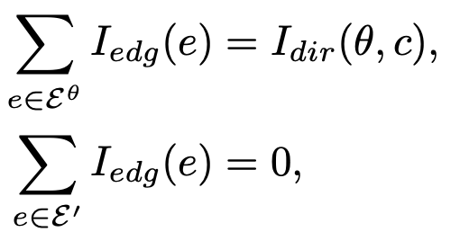
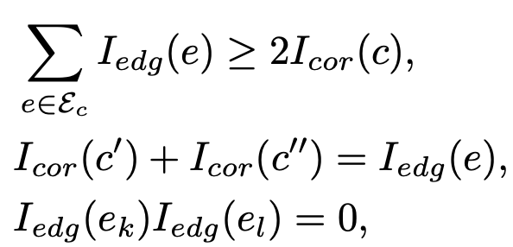
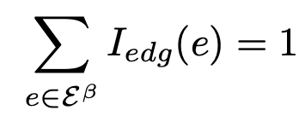
Bottom-up approaches
Optimize the detected primitives by IP to reconstruct topologies.
Corner-to-edge relationship constraints:
1) connect corners by bins
2) no corner (<0.2), no edge
Four independent models for (1) corner & corner-to-edge, (2) edge, (3) region, (4) region-to-region.
Slow IP: normally 5 mins, 1 hour for complex with 256*256 input.
The representing power of mask-based relationships is weak.
Region-to-region relationship constraints:
1 edge per r2r instance
Topology constraints:
1) 1 corner with >=2 edges
2) 1 edge with 2 corners
3) edges not intersect

Slide 10
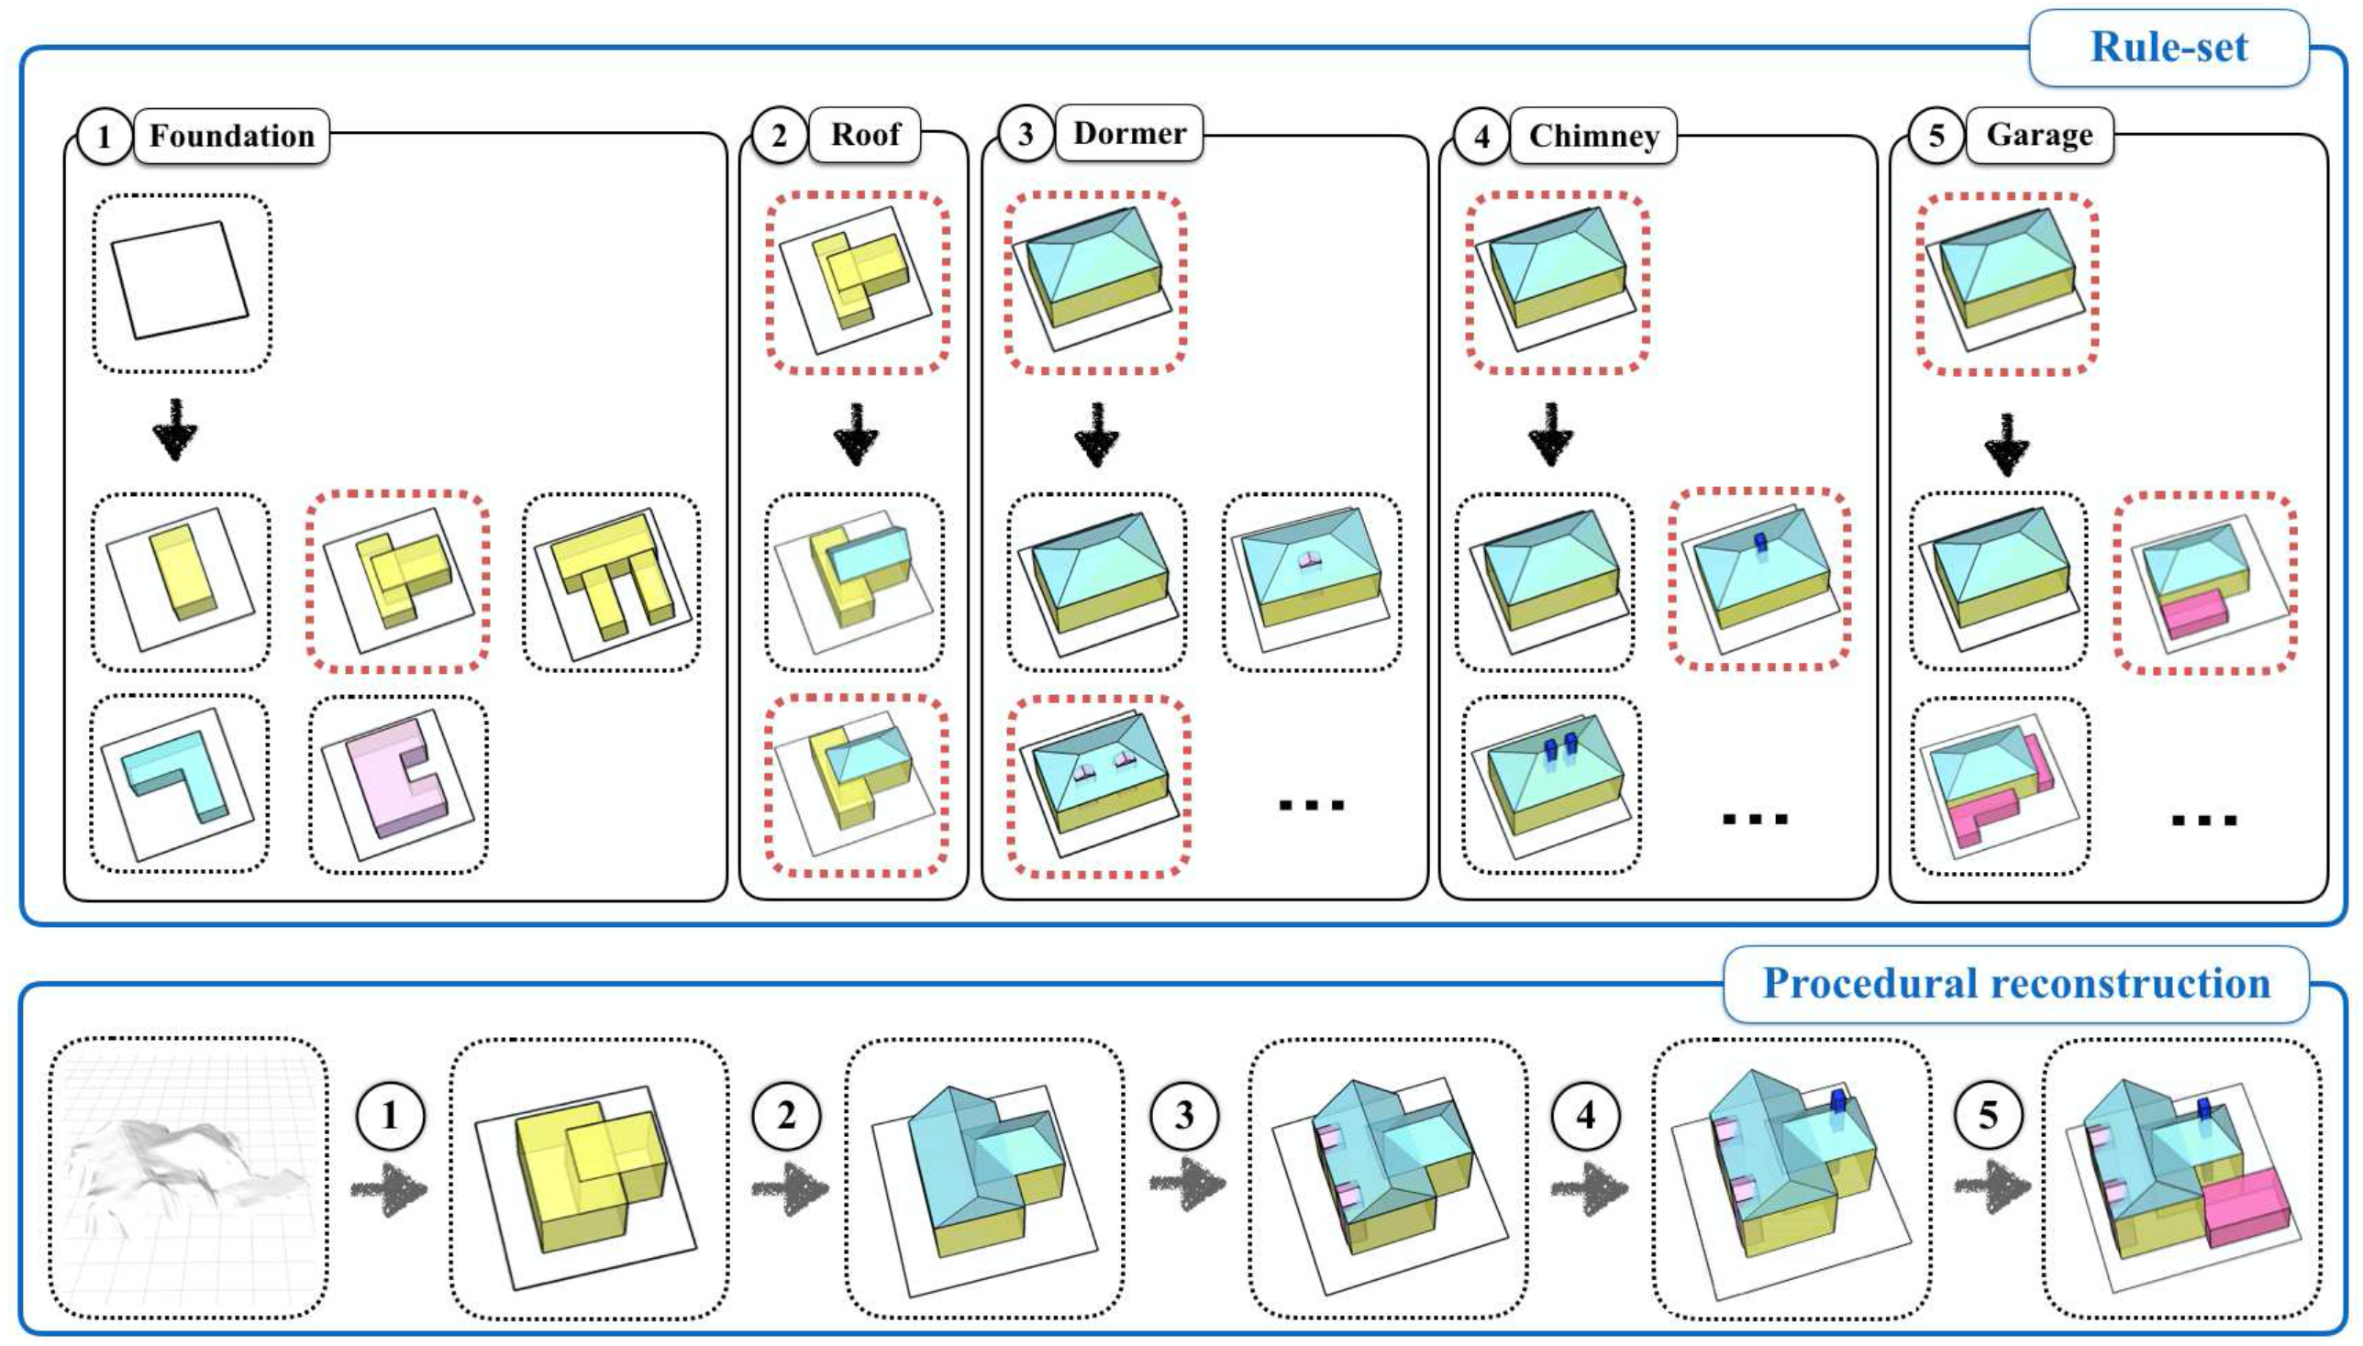
Top-down approaches
Neural Procedural Reconstruction for Residential Buildings. Zeng, Wu, and Furukawa. ECCV 2018.
Input: 3D points (incomplete and sparse)
Method: global analysis of entire building structure
5 stages + 7 shape grammar rules

Slide 11
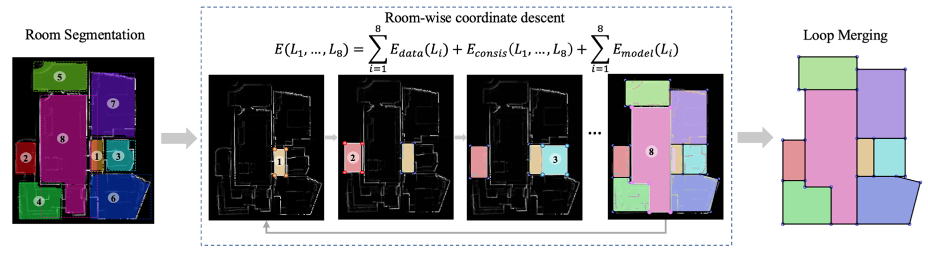
Top-down approaches
Chen, J., Liu, C., Wu, J., and Furukawa, Y. “Floor-SP: Inverse CAD for Floorplans by Sequential Room-wise Shortest Path.” ICCV 2019.
Network output:
Mask R-CNN output region mask
Dilated Residual Networks (DRN) output corner heatmap
DRN output edge heatmap
How to capture structure info:
Edge semantic mask + room instance mask
Need SP optimization to extract parametric structure

Slide 12
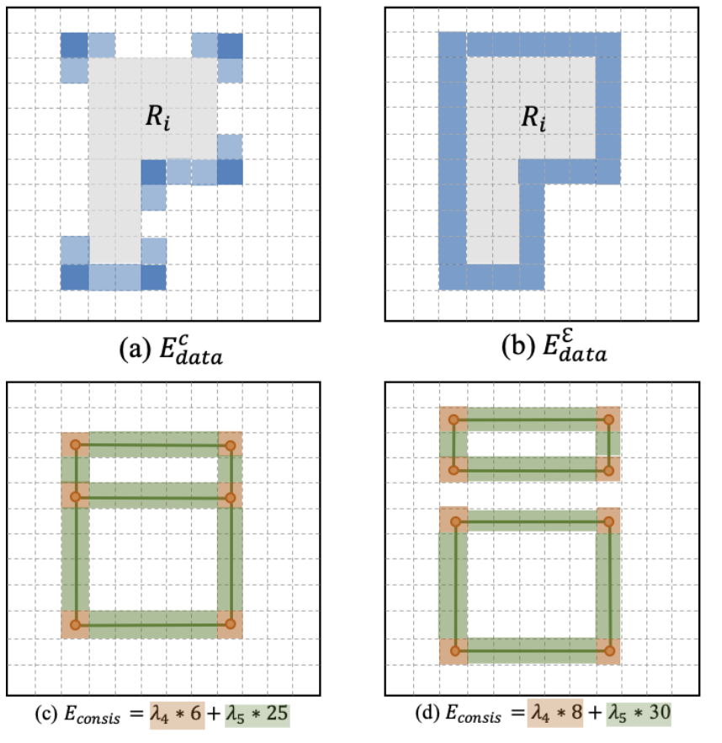
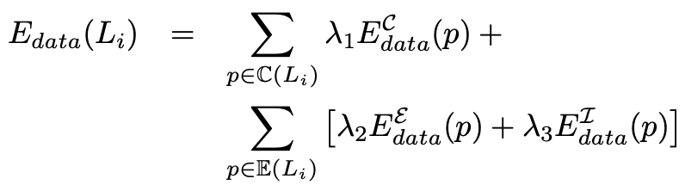
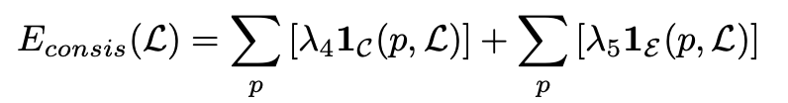
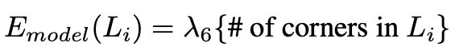
Top-down approaches
How to recover structure information:
IP can remove spurious corners, but cannot recover missed. Shortest path optimization recovers missed corners. (Dijkstra’s algorithm).
Problems:
Primitive detection as normal categories, not improved by structural prior
SP is slow, 5mins for 256*256
Room instance seg suffers from instance sensitivity
8 dominant directions
out corners on in corners
out edges on in edges
out edges not on in regions
merging closing corners / edges
minimize the number of corners

Slide 13
Decomposition of structured graphs
Towards real-time and end-to-end structured modeling:
Edge-based decomposition + Object detection
Research gaps between structured modeling and object detection
Object relationships
High requirement of localization precision
​Instance sensitivity
​Unique properties: symmetric, ambiguous direction of axes
(1) Y. Xu, X. Shen, Samsung Lee, Xuesong Li. 3D Object Detection with Deep Neural Networks for Automatic As-built Recons- truction [J]. Journal of Construction Engineering and Management, ASCE. In press .(IF : 2.734, JCR Q1) (2) Y. Xu, X. Shen, Samsung Lee. CorDet : Corner-aware 3D Object Detection Networks for Automated Scan-to-BIM [J]. Journal of Computing in Civil Engineering, ASCE. In press .(IF : 3.46, JCR Q1)
(3) Y. Xu, J. Cheng, X. Shen, Samsung Lee. Floor-Det : Relation-aware object detection network for automatic floorplan re- construction [J]. Automation in Construction, under review .(IF : 5.669, JCR Q1)

Slide 14
Floor-Det: real-time floorplan reconstruction through relation-aware object detection
real-time and end-to-end
simultaneous sub-tasks: classification, localization, and relation reasoning
simple heuristic post-processing

Slide 15
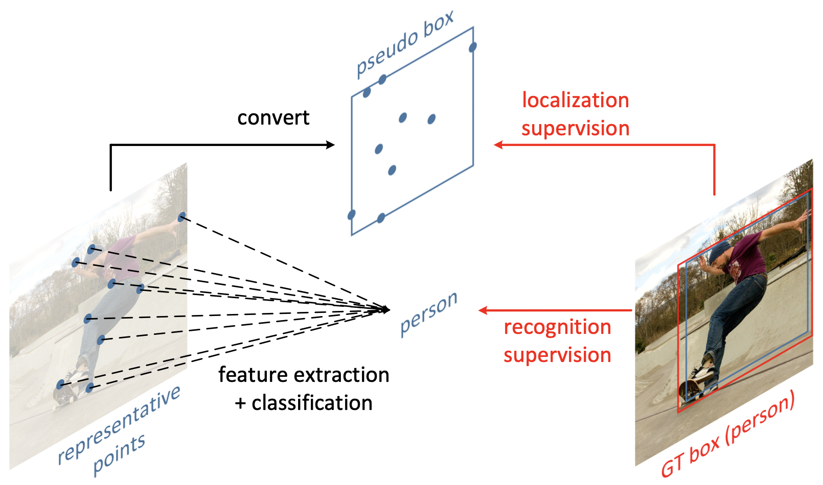
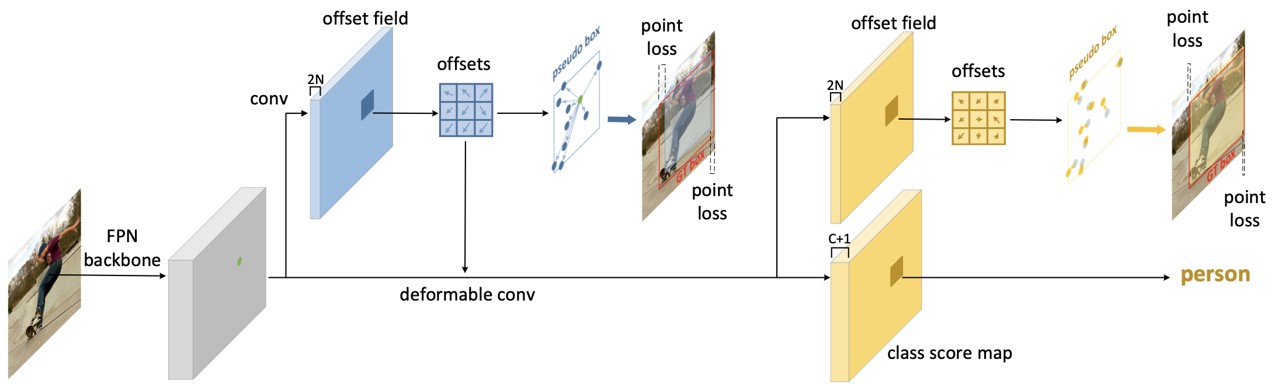
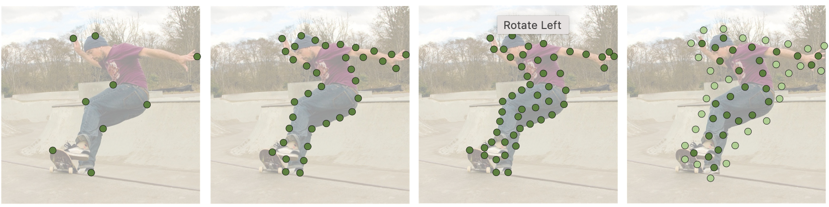
RepPoints framework
Z. Yang, S. Liu, H. Hu, L. Wang, S. Lin. RepPoints: Point Set Representation for Object Detection, ICCV 2019.
Box-based representation:
Anchors, proposals, predictions
Coarse locations of objects
Coarse extraction of object features
Point-based representation:
A set of sample points
Automatically arrange RepPoints geometrically (supervised) & indicates semantically significant local areas (un-supervised)
Beneficial for both localization and recognition
Anchor-free
For structural modeling:
Flexible shapes in unified framework
Finer discriminative features for two-stage pipeline
Fusing object-level and local features
Integrate object and structural information

Slide 16
An end-to-end framework for floorplan reconstruction based on object detection

Slide 17
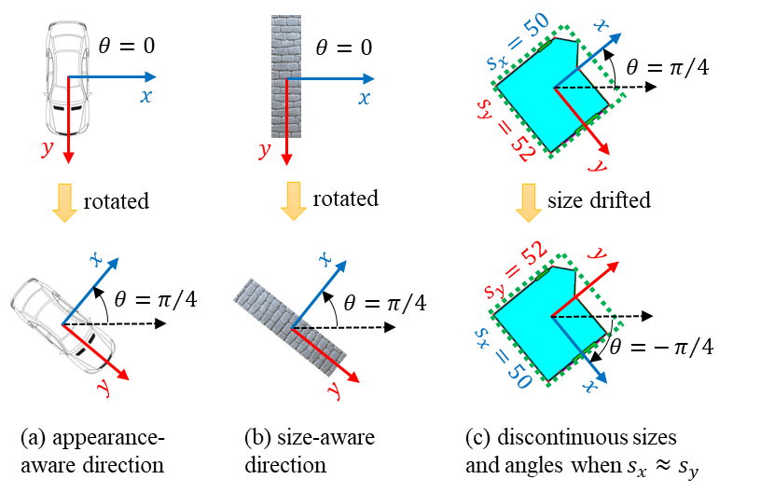
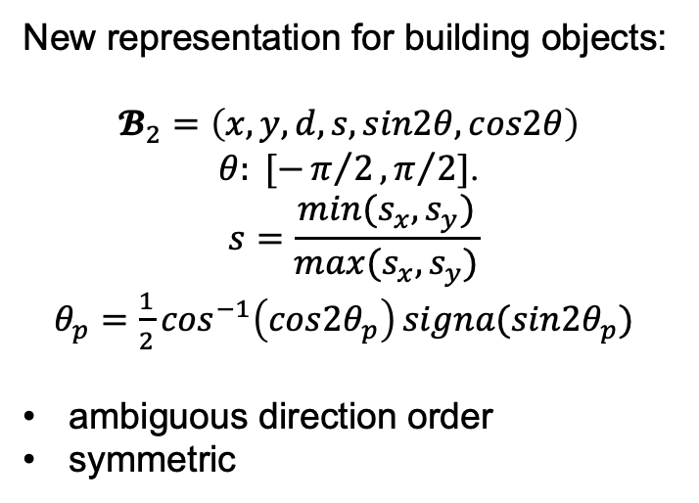
Object representations for detecting building primitives
Widely used representation: $𝓑_{1}=\left(x,y,s_{x},s_{y},θ\right)$
New representation for building objects:
$𝓑_{2}=\left(x,y,d,s, sin2θ,cos2θ\right)$
$θ: [−π/2,π/2]$.
$$s=\frac{min⁡(s_{x},s_{y})}{max⁡(s_{x},s_{y})}$$
$θ_{p}=\frac{1}{2}\cos^{−1}\left({cos2θ}_{p}\right)signa({sin2θ}_{p})$
ambiguous direction order
symmetric
(a) (b) (c)
appearance-aware direction;
size-aware direction;
(c) discontinuous sizes and angles when 𝑠𝑥≈𝑠𝑦.

Slide 18
Object Refinement using a point-based representation
(a) axis-aligned RoI, (b) rotated RoI, and (c) point-based refinement

Slide 19
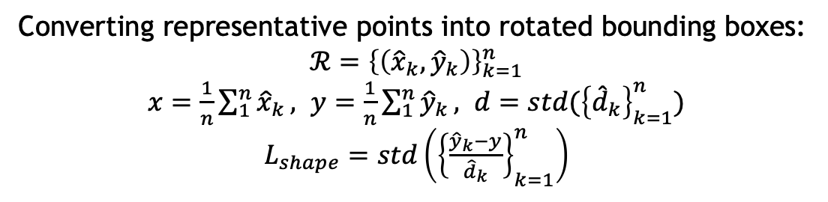
Object Refinement using a point-based representation
Converting representative points into rotated bounding boxes:
$ℛ={\left\{\left({\hat{x}}_{k},{\hat{y}}_{k}\right)\right\}}_{k=1}^{n}$
$x=\frac{1}{n}\sum_{1}^{n}{{\hat{x}}_{k}}, y=\frac{1}{n}\sum_{1}^{n}{{\hat{y}}_{k}}, d=std({\left\{{\hat{d}}_{k}\right\}}_{k=1}^{n})$
$L_{shape}=std\left({\left\{\frac{{\hat{y}}_{k}−y}{{\hat{d}}_{k}}\right\}}_{k=1}^{n}\right)$

Slide 20
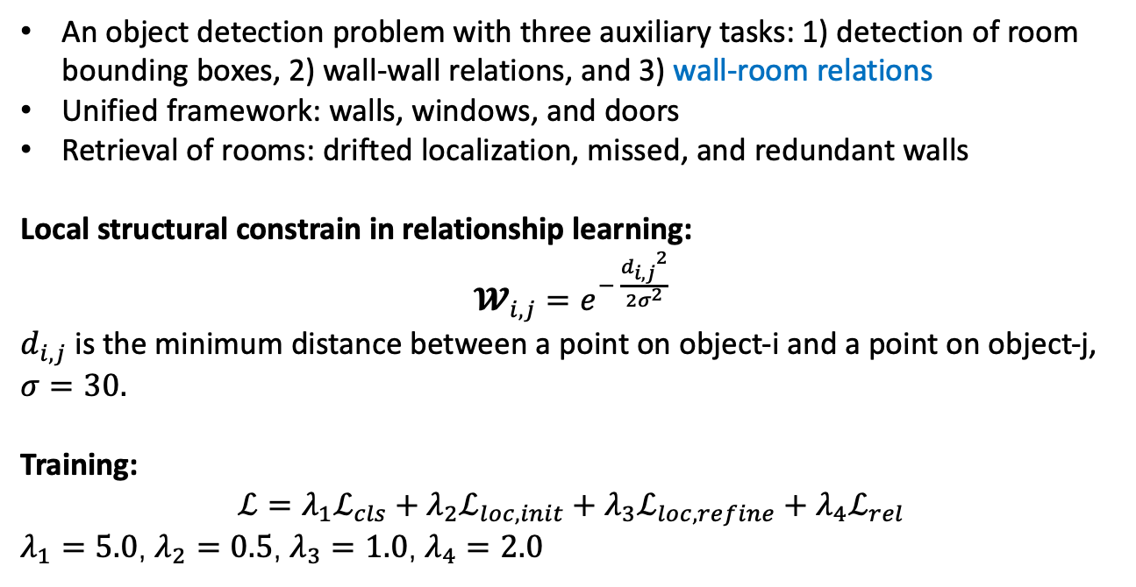
An end-to-end framework for floorplan reconstruction based on object detection
An object detection problem with three auxiliary tasks: 1) detection of room bounding boxes, 2) wall-wall relations, and 3) wall-room relations
Unified framework: walls, windows, and doors
Retrieval of rooms: drifted localization, missed, and redundant walls
Local structural constrain in relationship learning:
$𝓦_{i,j}=e^{− \frac{{d_{i,j}}^{2}}{2σ^{2}}}$
$d_{i,j}$ is the minimum distance between a point on object-i and a point on object-j, $σ=30.$
Training:
$$ℒ=λ_{1}ℒ_{cls}+λ_{2}ℒ_{loc,init}+λ_{3}ℒ_{loc,refine}+λ_{4}ℒ_{rel}$$
$λ_{1}=5.0$, $λ_{2}=0.5$, $λ_{3}=1.0$, $λ_{4}=2.0$

Slide 21
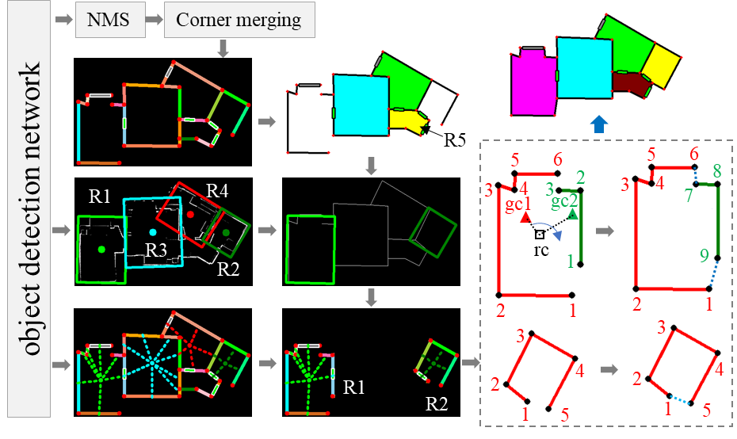
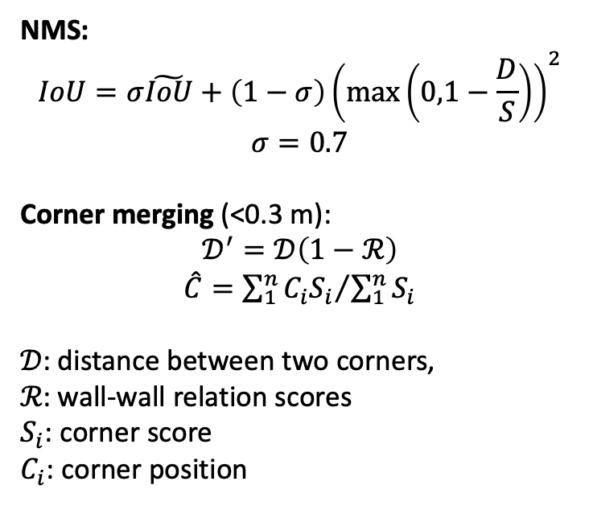
An end-to-end framework for floorplan reconstruction based on object detection
NMS:
$$IoU=σ\tilde{IoU}+\left(1−σ\right){\left(\max\left(0,1−\frac{D}{S}\right)\right)}^{2}$$
$$σ=0.7$$
Corner merging (<0.3 m):
$$𝒟^{′}=𝒟\left(1−ℛ\right)$$
$\hat{C}={\sum_{1}^{n}{C_{i}S_{i}}}/{\sum_{1}^{n}{S_{i}}}$
𝒟: distance between two corners,
ℛ: wall-wall relation scores
$S_{i}$: corner score
$C_{i}$: corner position

Slide 22
Experiments and validation for Floor-Det

Slide 23
Experiments and validation for Floor-Det

Slide 24
Experiments and validation for Floor-Det

Slide 25
Experiments and validation for Floor-Det

Slide 26
Experiments and validation for Floor-Det
Two key challenges for the edge-based approach are 1) detection of short edges, 2) precise regression of edge length.
Detections of rooms and wall-room relations: (a), (b) and (e) are room detections of scan-1, -7, and -11; (c) and (d) are wall-room relations of scan-7 and -10, respectively.

Slide 27
Typical low-quality floorplan reconstruction results
Typical failure cases: 1) too many edges missed, 2) complex structures, 3) small rooms.

Slide 28
Discussion and limitations
Floor-Det suffers from two key problems: 1) missed and drifted wall-edges, and 2) wall-room relations of rooms with complex shapes.
Future work:
Small object detection
Longest wall instance pattern
Higher input resolution
Precise object localization
A stronger relation learning method: attention mechanism
A unified framework
Currently, two independent models are trained to overcome the large overlap issue between walls and windows.
3D point cloud input

Slide 29
Discussion and limitations

Slide 30
CorDet: Corner-aware 3D Object Detection Networks for Automated Scan-to-BIM
Unique properties of building primitives:
Instance sensitivity: boundaries are determinated by corners
Bounding box-shaped
Meaningful local features around corners
Object relationships can be represented based on corners

Slide 31
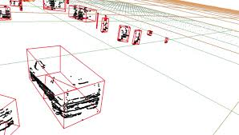
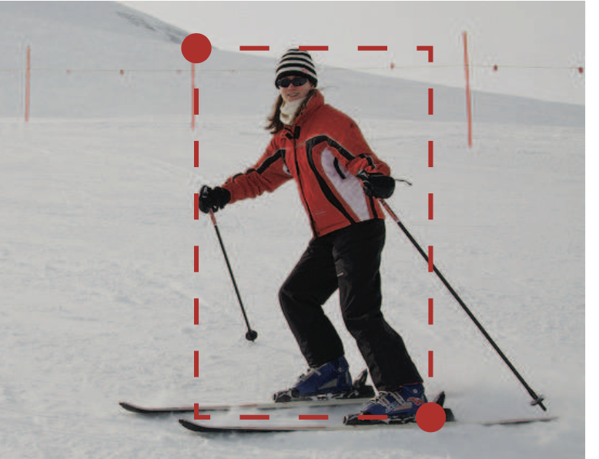
CorDet: Corner-aware 3D Object Detection Networks for Automated Scan-to-BIM
Unique properties of building primitives:
Instance sensitivity: boundaries are determinated by corners
Bounding box-shaped
Meaningful local features around corners
Object relationships can be represented based on corners
exactly box-shaped
appearance-aware instance
corners on the background

Slide 32
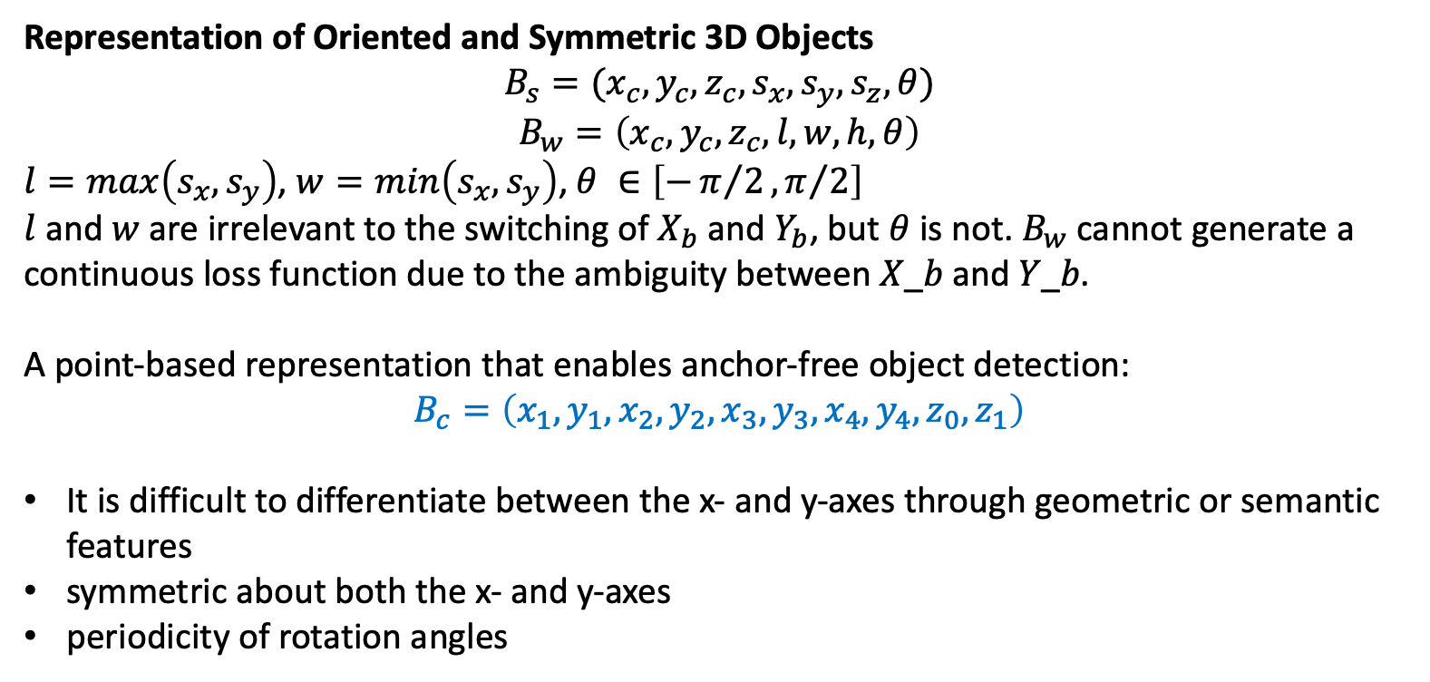
CorDet: Corner-aware 3D Object Detection Networks for Automated Scan-to-BIM
Representation of Oriented and Symmetric 3D Objects
$$B_{s}=(x_{c},y_{c},z_{c},s_{x},s_{y},s_{z},θ)$$
$$B_{w}=\left(x_{c},y_{c},z_{c},l,w,h,θ\right)$$
$l=max\left(s_{x},s_{y}\right)$, $w=min\left(s_{x},s_{y}\right)$, $θ ∈\left[−π/2,π/2\right]$
$l$ and $w$ are irrelevant to the switching of $X_{b}$ and $Y_{b}$, but $θ$ is not. $B_{w}$ cannot generate a continuous loss function due to the ambiguity between 𝑋_𝑏 and 𝑌_𝑏.
A point-based representation that enables anchor-free object detection:
$$B_{c}=\left(x_{1},y_{1},x_{2},y_{2},x_{3},y_{3},x_{4},y_{4},z_{0},z_{1}\right)$$
It is difficult to differentiate between the x- and y-axes through geometric or semantic features
symmetric about both the x- and y-axes
periodicity of rotation angles

Slide 33
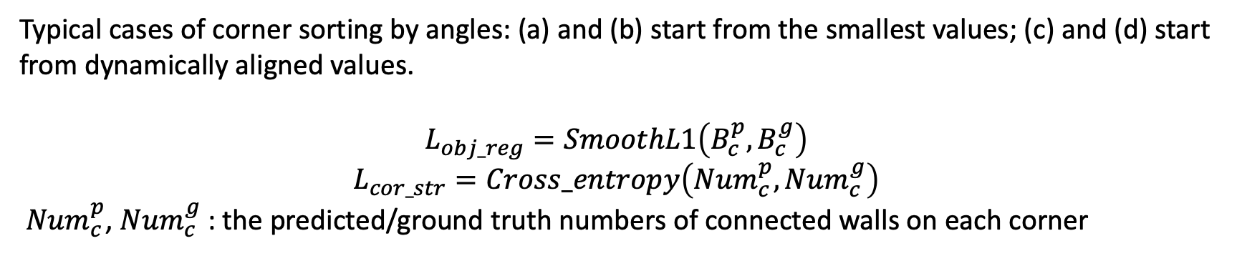
CorDet: Corner-aware 3D Object Detection Networks for Automated Scan-to-BIM
The consistent order of corners
Typical cases of corner sorting by angles: (a) and (b) start from the smallest values; (c) and (d) start from dynamically aligned values.
$$L_{obj_reg}=SmoothL1\left(B_{c}^{p},B_{c}^{g}\right)$$
$$L_{cor_str}=Cross_entropy\left({Num}_{c}^{p},{Num}_{c}^{g}\right)$$
${Num}_{c}^{p}$, ${Num}_{c}^{g}$: the predicted/ground truth numbers of connected walls on each corner

Slide 34
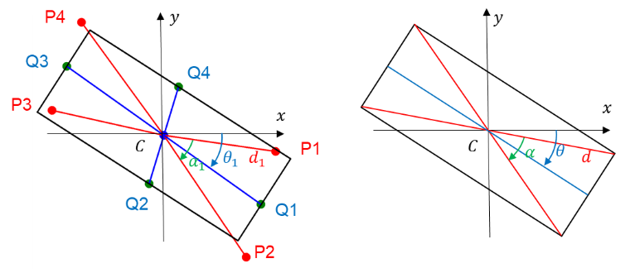
CorDet: Corner-aware 3D Object Detection Networks for Automated Scan-to-BIM
Converting four corners to an oriented and symmetric bounding box
(a) predicted corners and middle parameters
(b) parameters of the generated bounding box

Slide 35

CorDet: Corner-aware 3D Object Detection Networks for Automated Scan-to-BIM
Three stages: (i) initial object detection, (ii) object refinement, and (iii) merging objects with a corner heatmap.

Slide 36
CorDet: Corner-aware 3D Object Detection Networks for Automated Scan-to-BIM

Slide 37
CorDet: Corner-aware 3D Object Detection Networks for Automated Scan-to-BIM

Slide 38
CorDet: Corner-aware 3D Object Detection Networks for Automated Scan-to-BIM

Slide 39


Object-based structured modeling
Independent object detection:
Armeni，et al., 3d semantic parsing of large-scale indoor spaces, CVPR 2016.
H. Zeng, K. Joseph, A. Vest, Y. Furukawa, Bundle Pooling for Polygonal Architecture Segmentation Problem, CVPR, 2020.
Same as ordinary objects
No relational constraint
Prior-knowledge used for polygonal regression.
Relationships are recovered in post-processing.

Slide 40



Object-based structured modeling
Y. Xu, W. Xu, D. Cheung, and Z. Tu, Line Segment Detection Using Transformers without Edges, ArXiv210101909 Cs, 2021.
End-to-end pipeline for line segment detection
Transformers with multi-scale encoders/decoders

Slide 41

Relation-aware structured modeling
Y. Qian, Y. Furukawa. Learning Pairwise Inter-plane Relations for Piecewise Planar Reconstruction. ECCV 2020.
Orientation-CNN:
Input 8-channel img: 3(RGB) + 2(binary mask) + 2(depth maps) + 1(normal product)
Output 3 orientation types: parallel, orthogonal, or neither
Contact-CNN:
Same input
Output 1) touch or not + 2) contact line mask
Same with Floor-Det: get relationships by classification.
Difference: Pipeline and features used for relationship inference.
The relationships can be effectively classified.
Simultaneously seg & relation
Problems to be solved:
Independent segmentation for instances
Inter-plan inconsistencies
Under-segmentation

Slide 42



基于图像的室内结构重建
任务：用手机RGB摄像头重建室内3DLayout
方法：单帧透视版HorizonNet
单帧透视版HorizonNet：
对齐输入，Resize为512*512
Binary cross entropy 3*512 +
Linear regression 2*512
Backbone: RNN -> CNN
透视结构数据集生成：Matterport，Panocontext
Fov: 110*90, 82*66
结构分类
直线约束
Backbone: CNN -> Bot
融合SLAM位姿
HorizonNet（ICCV19）充分利用先验降低问题纬度：3*1024。

Slide 43












月球车惯性/视觉/天文组合导航
UKF:
EKF:
Y. Xu, X. Ning. A New Method of INS/VNS Integrated Navigation Method for Planetary Exploration Rover [J]. Chinese Journal of Space Science. 2015, 35(6) :721-729. X. Ning, M. Gui, Y. Xu. INS/VNS/CNS integrated navigation method for planetary rovers [J]. Aerospace Science and Tech- nology , 2015, 45 : 102-114. (IF : 4.499, JCR Q1)

Slide 44



惯性/视觉动作捕捉算法
磁罗盘标定 当前方法主要是基于椭球拟合，用户难以完成。开发了一个基于椭园拟合的标定方法。
惯性/光学组合动作捕捉 被动式光学捕捉精度高，但存在三个问题：1）抗遮挡能力差，2）Marker ID需要根据刚体形状确定，3）成本高（~正比相机数量）。开发了一种融合IMU和被动光学的定位方案：1) 根据捷联加速度和光学位置匹配关系 + 连续性 + 人体约束 确定Marker ID；2）通过惯性/光学融合提高抗遮挡能力，将8个相机见小到2～4个。

Slide 45
谢谢！ 徐勇志

